Slide 1
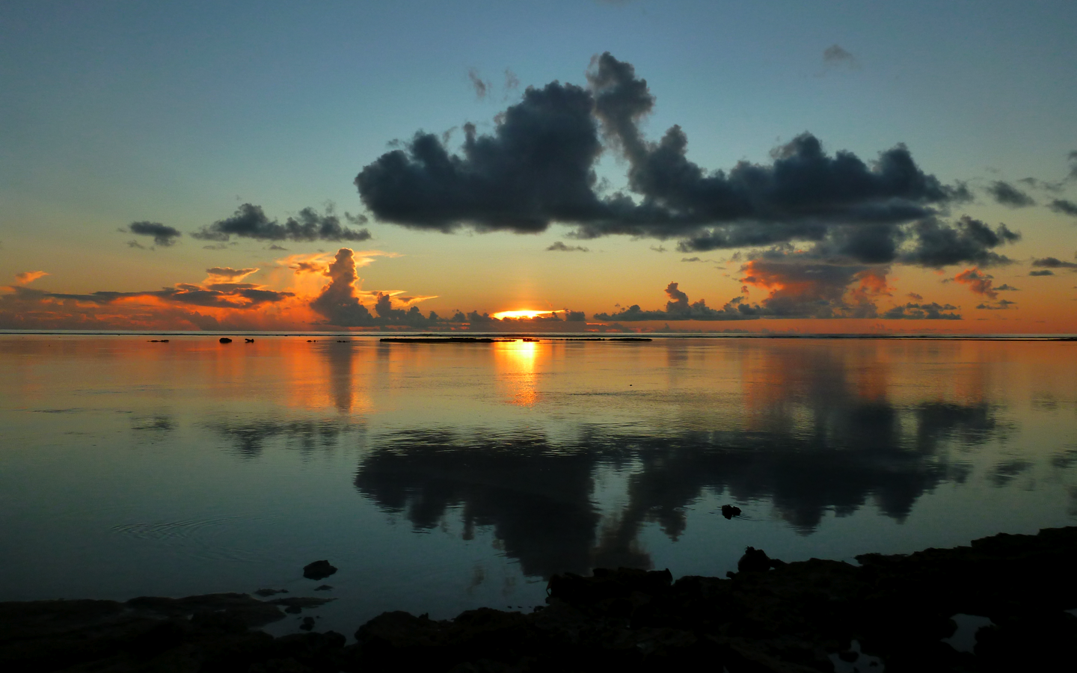
Dynamics of MJO Convective Onset during DYNAMO
Scott Powell
University of Washington, Seattle
University of Reading, 27 October 2015
Supported by grants AGS-1059611 and AGS-1355567 from the National Science Foundation, grant DE-SC0008452 from the U.S. Dept. of Energy, and grants NNX10AH70G and NNX13AG71G from the National Aeronautics and Space Administration.

Slide 2
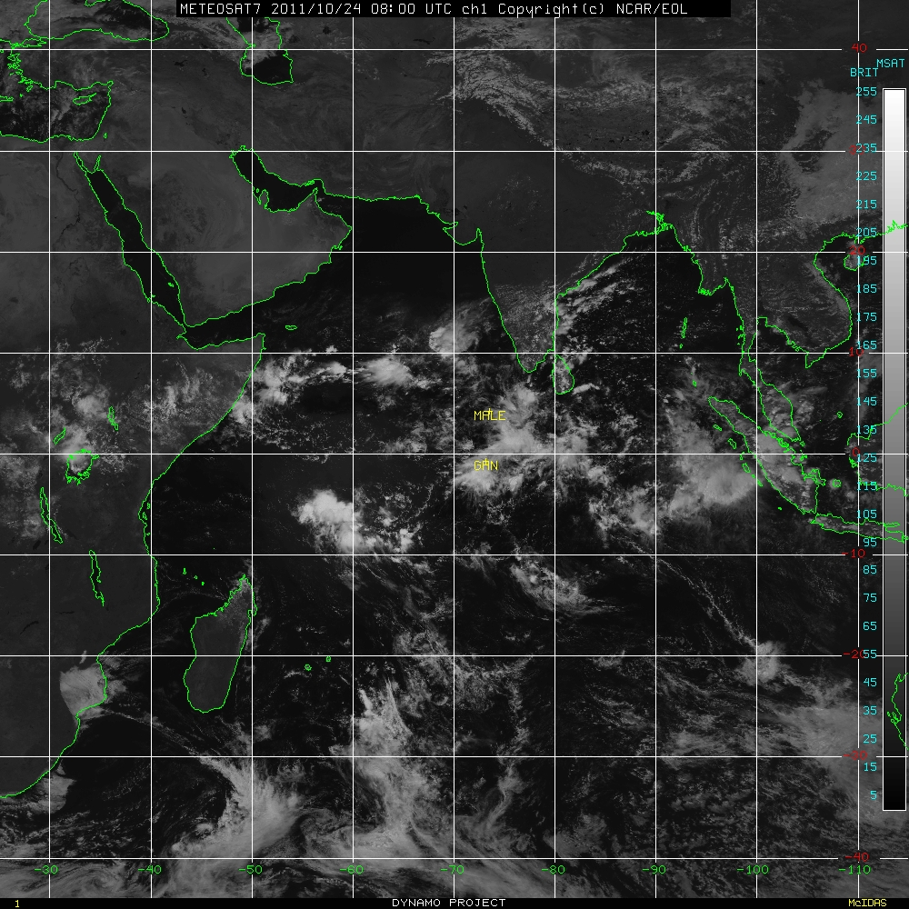
08 UTC, 24 Oct 2011

Slide 3
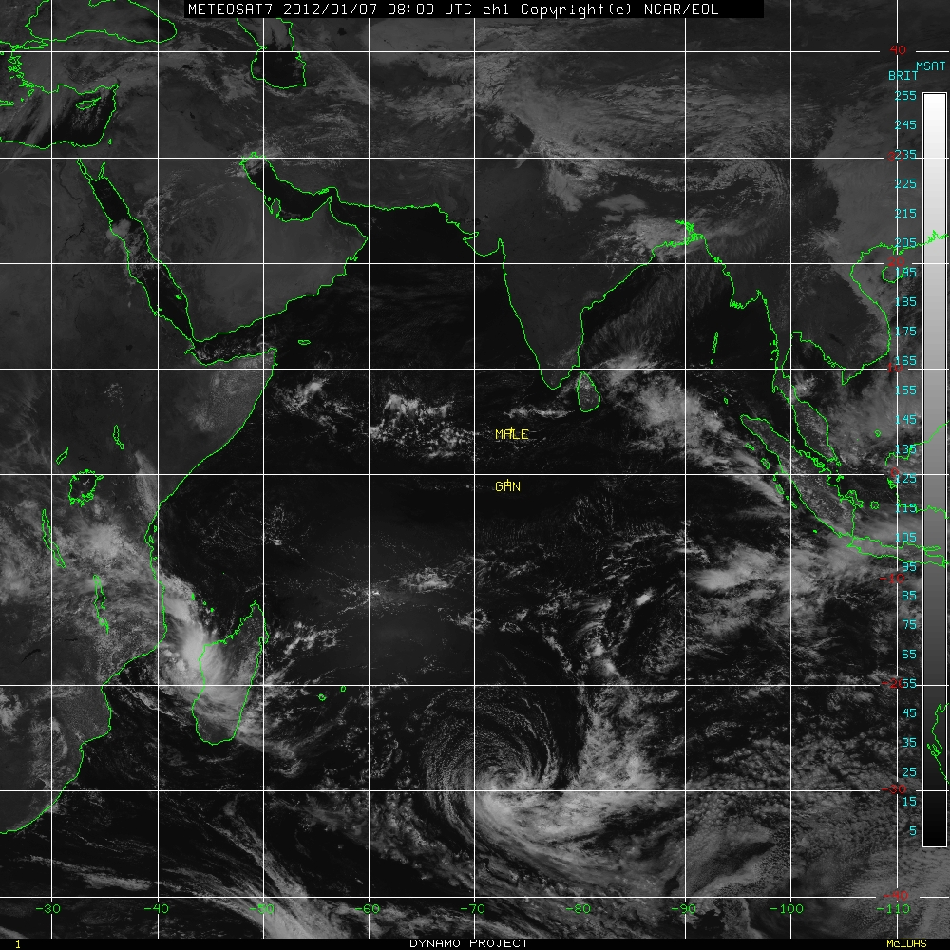
08 UTC, 7 Jan 2012

Slide 4
08 UTC, 24 Oct 2011

Slide 5
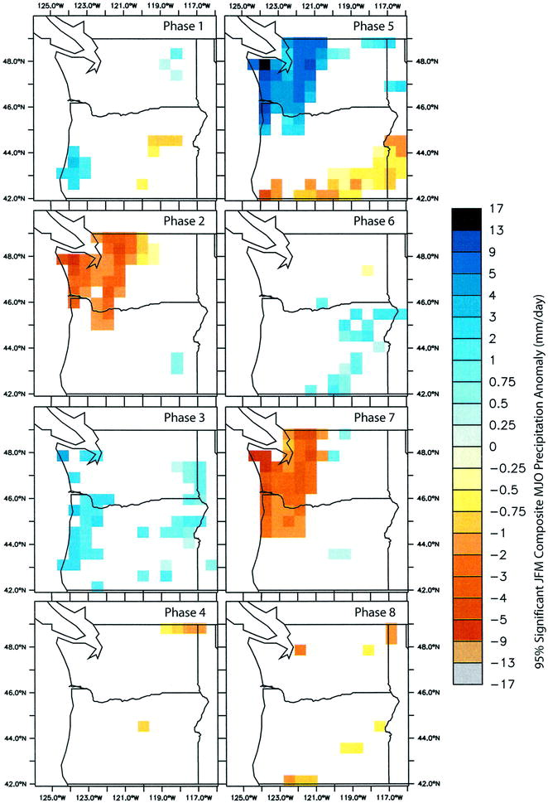
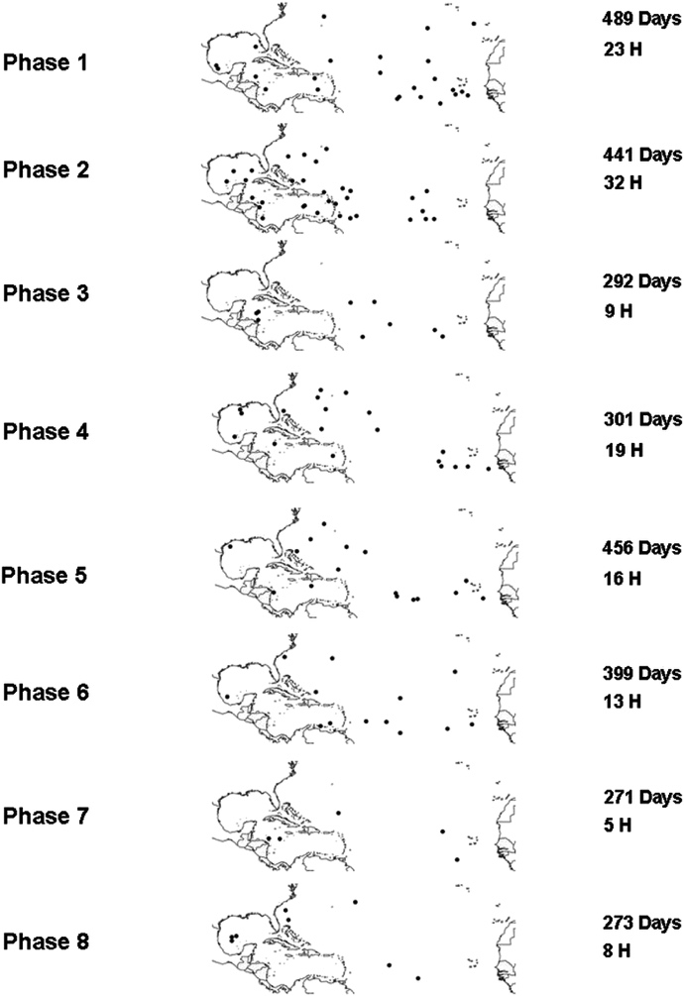
Bond and Vecchi 2003
Klotzbach 2014

Slide 6
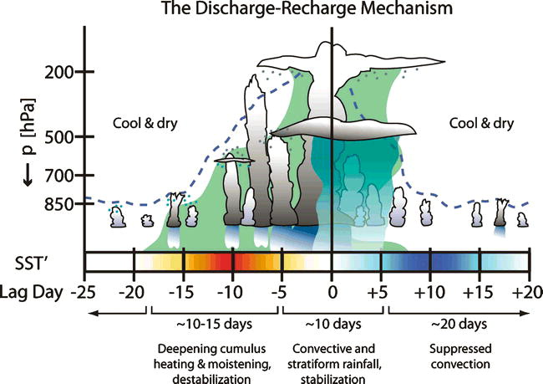
Hypothesis 1: Convection plays active role in MJO convective onset.
Benedict and Randall (2007)

Slide 7
Hypothesis 1: Convection plays active role in MJO convective onset.
Benedict and Randall (2007)
10–15 days or more!
27 October 2015
Powell: MJO Convective Onset Dynamics
7

Slide 8
Hypothesis 2: Convection passively responds to changes in large-scale environment.
Knutson and Weickmann (1987)

Slide 9
Hypothesis 2: Convection passively responds to changes in large-scale environment.
Knutson and Weickmann (1987)

Slide 10
Timescale of MJO Convective Build-up
What duration is the transition from suppressed to widespread convection?

Slide 12
Powell and Houze (2015a)

Slide 13
Powell and Houze (2015a)

Slide 14
Transition periods
TRMM 20dBZ echo tops: 9N–9S; 60–100E

Slide 15
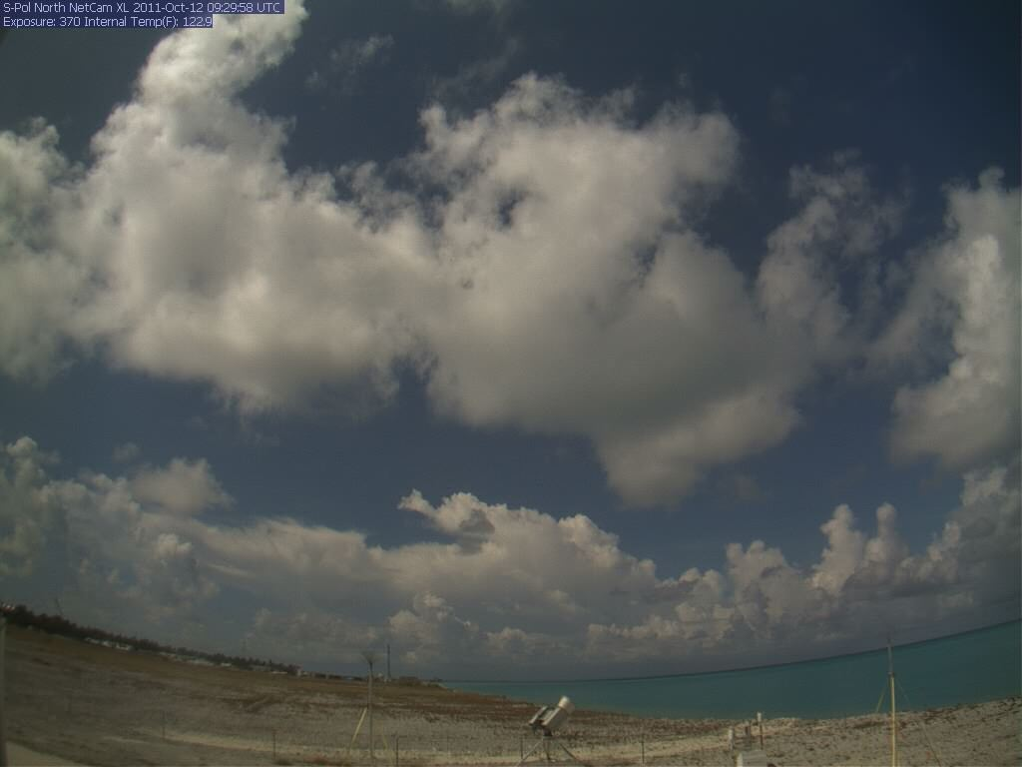
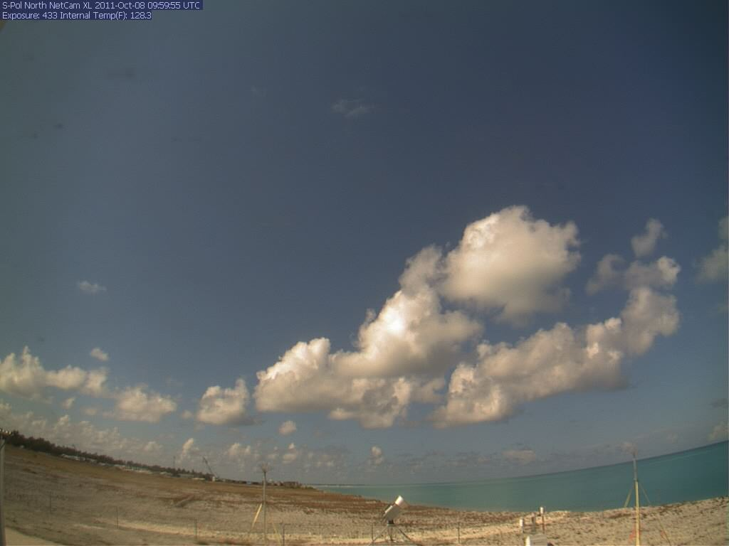
Transition periods
TRMM 20dBZ echo tops: 9N–9S; 60–100E

Slide 16
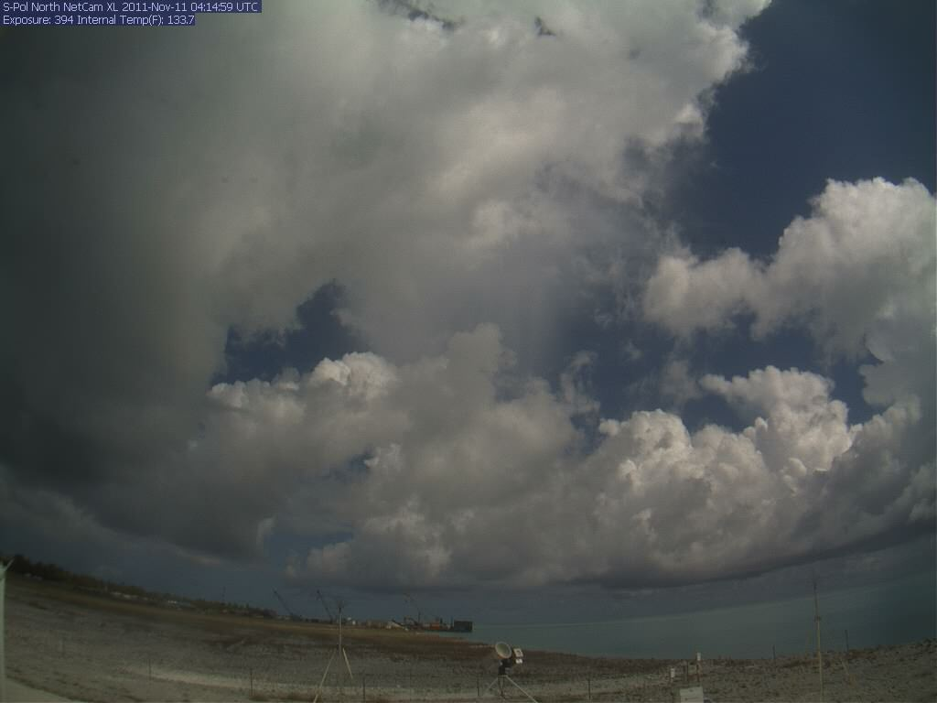
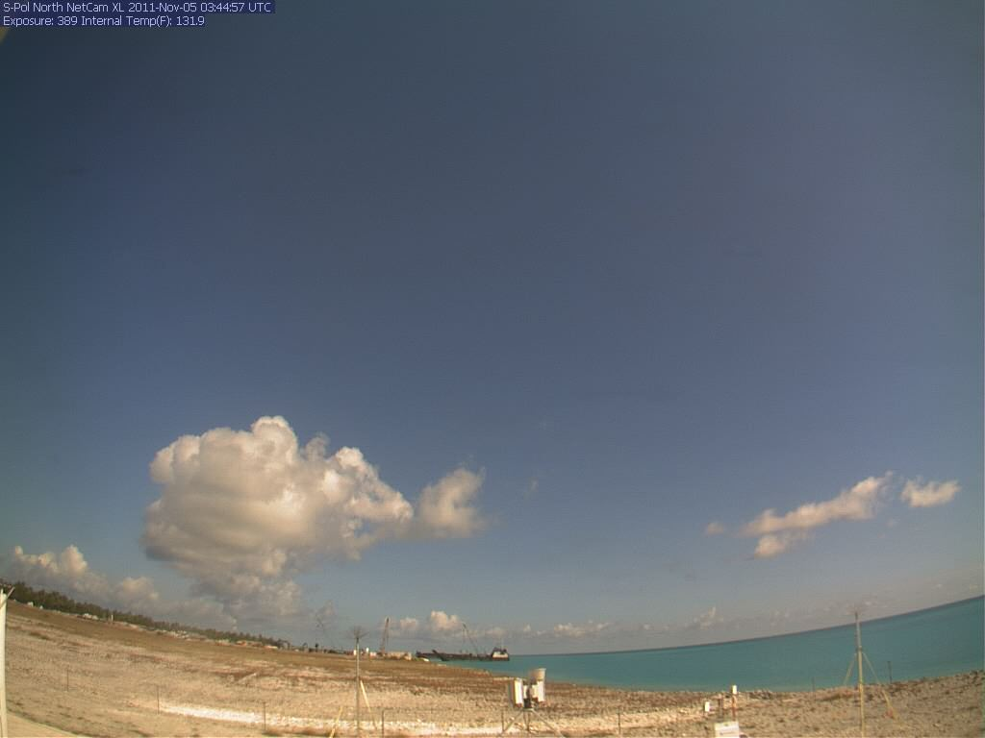
Transition periods
TRMM 20dBZ echo tops: 9N–9S; 60–100E

Slide 17
Transition periods are observed prior to MJO convective onset.
They last 3–7 days.
During them, moderately deep cumulonimbi are prevalent.

Slide 18
Moistening by Cumulonimbi
Do moderately deep clouds moisten the troposphere during transition periods, or does moistening permit cloud deepening?

Slide 19
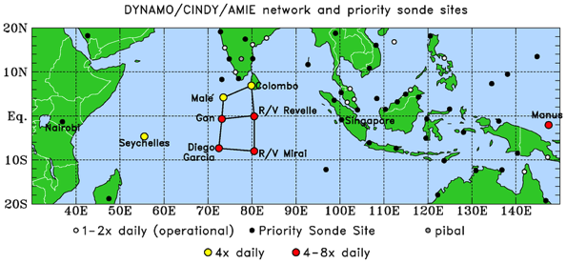

Slide 20
Purple = Cg
Black = Trans.
Red = Cb

Slide 23
Purple = Cg
Black = Trans.
Red = Cb

Slide 24
Purple = Cg
Black = Trans.
Red = Cb

Slide 25
Yes, moderately deep clouds do moisten the troposphere below 500 hPa prior to onset.
Upward redistribution of water vapor appears to be primary mechanism.

Slide 26
The Circumnavigating MJO (Kelvin wave?)
How does LS upper-tropospheric divergence relate to convection rooted in a warm, moist boundary layer?

Slide 27
Powell and Houze (2015b)

Slide 28
Powell and Houze (2015b)

Slide 29
Powell and Houze (2015b)
Smoothed ω′: Wave# ≤1.5
3B42 Precipitation

Slide 30
Smoothed ω′: Wave# ≤1.5
3B42 Precipitation

Slide 31
ω′
u′
Wave # ≤ 3
Wave # ≤ 1.5

Slide 32
Trans.
Cg

Slide 33
Global velocity potential/zonal wind anomalies strongest in upper troposphere, but accompanied by deep vertical velocity anomalies.
Reduction in large-scale subsidence steepens lapse rate/cools environment below 500 hPa.

Slide 34
Updraft Buoyancy within and Moistening by Simulated Cumulonimbi
What causes sudden onset of transition periods?

Slide 36
WRF (V3.5.1) Specifications
1–20 October and 4–20 November
ERA-I forcing with NOAA RTG High-Res SST
2km grid spacing, 38 vertical levels
Microphysics: Thompson
Radiation: RRTMG
PBL: MYJ
Monin-Obukhov surface layer physics
Noah LSM

Slide 38
Notes:
What is the distribution of 20 dBZ ETH composited over entire run?

Slide 40
Model grid points separated into 4 categories:
Precipitating
Non-precipitating liquid
Anvil
Environment

Slide 41
Updraft vs. Environment
Green
Gray
Blue
Red

Slide 42
Updraft vs. Environment
Green
Gray
Blue
Red

Slide 43
Updraft vs. Environment
Green
Gray
Blue
Red

Slide 44
Green
Red
Blue

Slide 45
Green
Red
Blue

Slide 46
Green
Red
Blue

Slide 47
Conclusions
3–7 day build up in cloud population during transition periods prior to MJO convective onset.
During transition periods, moderately deep clouds make environment conducive to deep convection.
Circumnavigating wave has impacts on low-wavenumber ω anomalies of O(0.01 Pa s⁻¹).
Changes in vertical velocity cause small changes of O(0.1K) in tropospheric temperature below 500 hPa.
Small changes in environmental temperature dramatically alter mean buoyancy of cloud updrafts in 700–850 hPa layer.

Slide 48
Conclusions
3–7 day build up in cloud population during transition periods prior to MJO convective onset.
During transition periods, moderately deep clouds make environment conducive to deep convection.
Circumnavigating wave has impacts on low-wavenumber ω anomalies of O(0.01 Pa s⁻¹).
Changes in vertical velocity cause small changes of O(0.1K) in tropospheric temperature below 500 hPa.
Small changes in environmental temperature dramatically alter mean buoyancy of cloud updrafts in 700–850 hPa layer.

Slide 49
Conclusions
3–7 day build up in cloud population during transition periods prior to MJO convective onset.
During transition periods, moderately deep clouds make environment conducive to deep convection.
Circumnavigating wave has impacts on low-wavenumber ω anomalies of O(0.01 Pa s⁻¹).
Changes in vertical velocity cause small changes of O(0.1K) in tropospheric temperature below 500 hPa.
Small changes in environmental temperature dramatically alter mean buoyancy of cloud updrafts in 700–850 hPa layer.

Slide 50
Conclusions
3–7 day build up in cloud population during transition periods prior to MJO convective onset.
During transition periods, moderately deep clouds make environment conducive to deep convection.
Circumnavigating wave has impacts on low-wavenumber ω anomalies of O(0.01 Pa s⁻¹).
Changes in vertical velocity cause small changes of O(0.1K) in tropospheric temperature below 500 hPa.
Small changes in environmental temperature dramatically alter mean buoyancy of cloud updrafts in 700–850 hPa layer.

Slide 51
Conclusions
3–7 day build up in cloud population during transition periods prior to MJO convective onset.
During transition periods, moderately deep clouds make environment conducive to deep convection.
Circumnavigating wave has impacts on low-wavenumber ω anomalies of O(0.01 Pa s⁻¹).
Changes in vertical velocity cause small changes of O(0.1K) in tropospheric temperature below 500 hPa.
Small changes in environmental temperature dramatically alter mean buoyancy of cloud updrafts in 700–850 hPa layer.

Slide 52
Conclusions
3–7 day build up in cloud population during transition periods prior to MJO convective onset.
During transition periods, moderately deep clouds make environment conducive to deep convection.
Circumnavigating wave has impacts on low-wavenumber ω anomalies of O(0.01 Pa s⁻¹).
Changes in vertical velocity cause small changes of O(0.1K) in tropospheric temperature below 500 hPa.
Small changes in environmental temperature dramatically alter mean buoyancy of cloud updrafts in 700–850 hPa layer.

Slide 53
End

Slide 54
Extra Slides

Slide 57
Powell and Houze (2013)

Slide 58
Powell and Houze (2013)

Slide 59
Notes:
Rapid build up observed at S-Pol.

Slide 62
Notes:
Compositing butchers time scale.

Slide 63
ERA-Interim

Slide 64
Model grid points separated into 4 categories:
Precipitating
Non-precipitating liquid
Anvil
Environment

